Slide 2
Notes to the Presenter
Slides 2-10 contain notes for the presenter and are hidden.
You may include your picture and company logo on the intro slide only
It is appropriate to provide a brief background (1 minute or less) on your organization.

Slide 3
Presentation Best Practices
Frame your presentation by answering:
What do you want your audience to learn?
What do you want your audience to do differently?
What result or outcomes do you want your audience to realize?
Clarify your session objectives at the beginning of your presentation.

Slide 4
Presentation Best Practices
Pictures speak 1,000 words; include a screenshot or picture on each slide to add visual interest.
A good goal is to aim for 7 words per slide.
Increase attention and interaction by using a variety of communication mediums, such as polls and videos.
Plan and follow a rough agenda including a breakdown by minute to help stay on track.

Slide 5
Example of Text Layout
Main topic 1: size 28pt
Size 24pt for the subtopics
Size 24pt for the subtopics
Main topic 2: size 28pt
Size 24pt for the subtopics
Size 24pt for the subtopics
Main topic 3: size 28pt
Size 24pt for the subtopics
Size 24pt for the subtopics

Slide 6
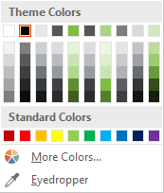
Slide Palette Info
The PowerPoint palette for this template has been built for you and is shown below. Avoid using too many colors in your presentation.
Select the 4th color from the left for subheads and 1st level non-bulleted text color, or wherever “color” text is preferred over the default black/white text
Accent colors 1-6 – (6 Theme Colors to the far right)
Text
Dark 2
Accent 1
Accent 2
Accent 3
Accent 4
Accent 5
Accent 6
Use Accent 1 as the main accent color. Use Accent 2 and Accent 3 when additional colors are needed.
Use Accents 4-6 sparingly – only when more colors are necessary.

Slide 7
Chart Example

Slide 8
Lots of data? Minimalize and Plan
Gray is used to de-emphasize data that is less important. Use cool gray 3 or cool gray 7. See slide 7 for color formulas.
All elements have the same interior margins as text blocks.
When a chart or graphic, has more elements than can easily be aligned to the grid, align the outer edges of the group, top, bottom, left and right edges to the grid.
It is preferable to keep the group aligned to the left border.
130M
140M
125M
Other
Other
Other
Other
Other
Other

Slide 9
Chart Example

Slide 10
Notes (hidden)
Some speakers like to use this slide for hidden “notes slides”.
Delete it if you don’t want to use it.

Slide 11
Power BI in D365 Unified Operations (and AX) – Our Experience
Eric Lampron

Slide 12


Eric Lampron Thinkmax Executive VP, Technology
With more than 20 years of experience in IT consulting, Éric is a seasoned technical architect and project manager specializing in the implementation of Microsoft Dynamics and business intelligence systems. His mastery of Microsoft solutions gives him a privileged understanding of the companies for whom he works, advises and guides during their transition to Microsoft Dynamics 365 (AX).

Slide 13
Power BI in D365 Unified Operations (and AX) – Our Experience
Clarify the different approaches for consuming BI in D365 Unified Operations
Help you in making the right choices for your business
Encourage you in embarking on this wonderful journey

Slide 14
Session Agenda
Overview of the Data Access in D365 FO
Entity Store and Power BI Embedded experience in D365 FO
BYOD and Data Entities
What’s Available for previous AX version
What’s Ahead

Slide 15
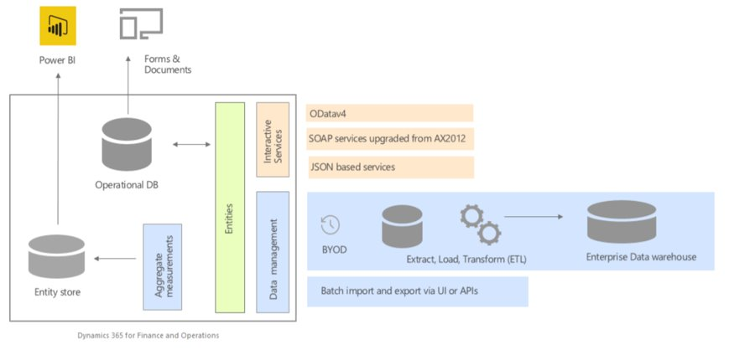
D365 FO ​​
Data Access Architecture

Slide 16
Power BI and the Entity Store
Embedded insights in Finance and Operations
Tools for power users and developers in
Finance and Operations
License Bundled with your subscription
Analytical workspaces offer contextual analytics
Analytical workspaces let you drill back to Finance and Operation to

Slide 17
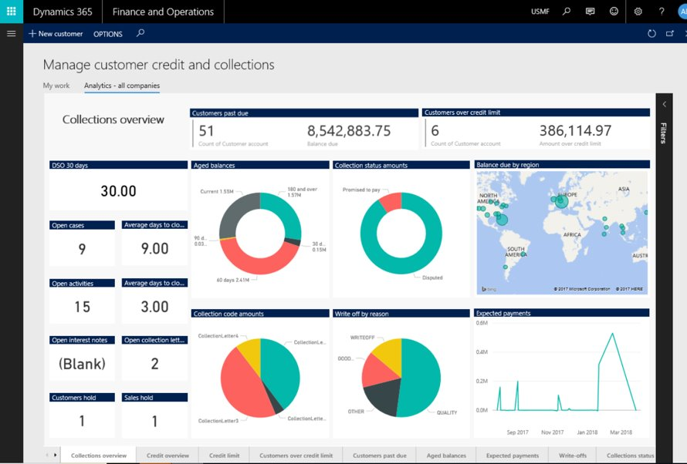
Power BI and the Entity Store

Slide 18
BYOD and Data Entities
Combined analytics that use data from various systems
Most development is done by Power User
Needs extra licenses
Need to build the model from scratch
Easy to merge Historical data

Slide 19
Previous Versions of AX
Retrofitted D365 FO Data entity views
Minor changes needed when migrating to latest version

Slide 21
Software code slide
This slide layout uses Consolas, a monotype font which is ideal for showing software code.

Slide 22
Any Questions?

Slide 23
Thank You For Attending

